Slide 1
Elasticity of Demand
Meaning, Types of elasticity, Influencing factors

Slide 2
Elasticity of Demand
Elasticity measures the responsiveness of one variable to the variations in another variable. Thus, the elasticity of X with respect to Y, e, is defined as
Percentage change in X
e =
Percentage change in Y

Slide 3
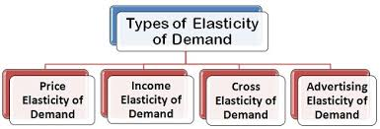

Slide 4
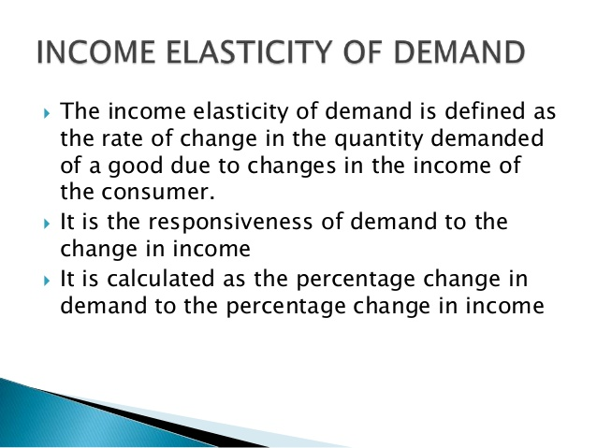

Slide 5
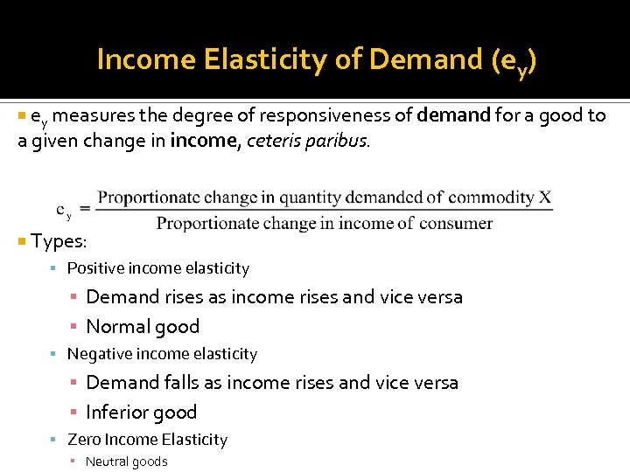

Slide 6
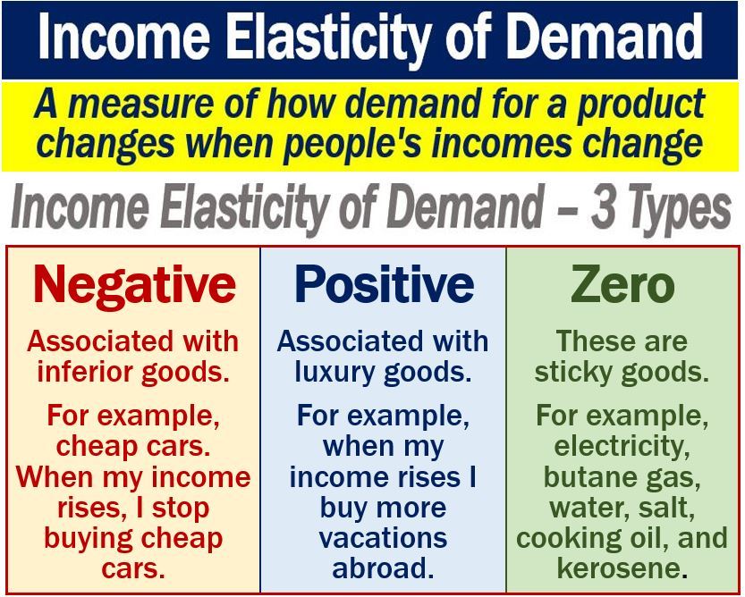

Slide 7
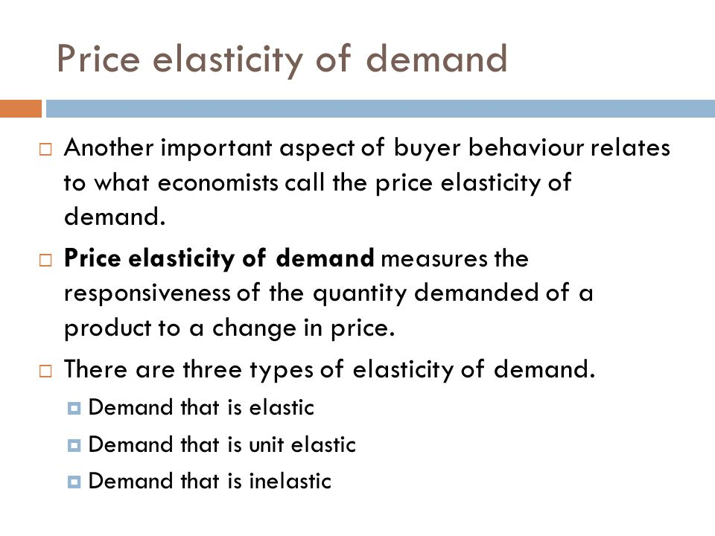

Slide 8
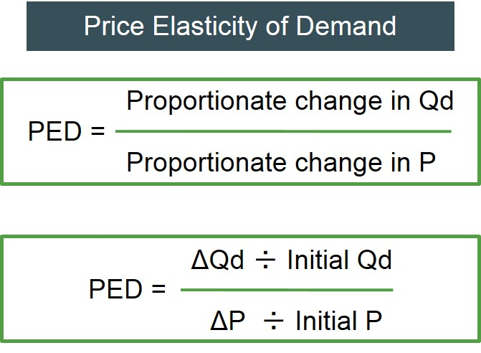

Slide 9
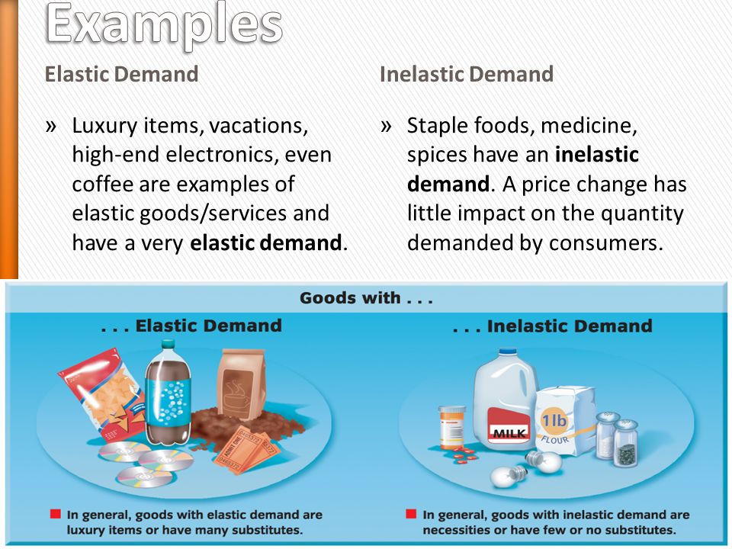

Slide 10
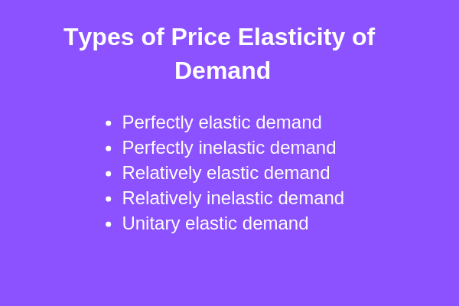

Slide 11
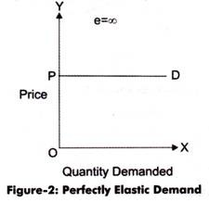
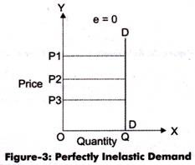
Perfectly Elastic Vs. Inelastic Demand

Slide 12
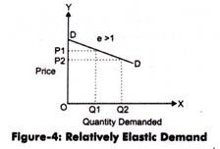
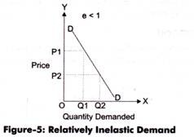
Relatively Elastic Vs. Inelastic Demand

Slide 13
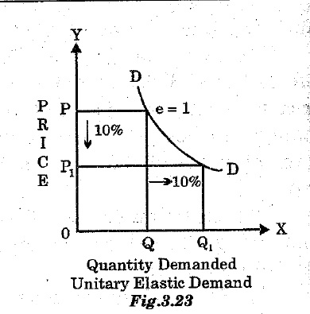
Unitary Elastic Demand

Slide 14
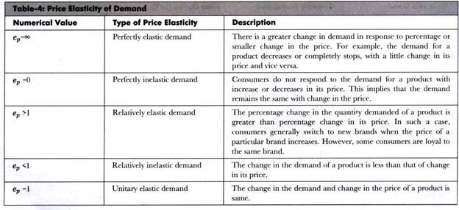

Slide 15
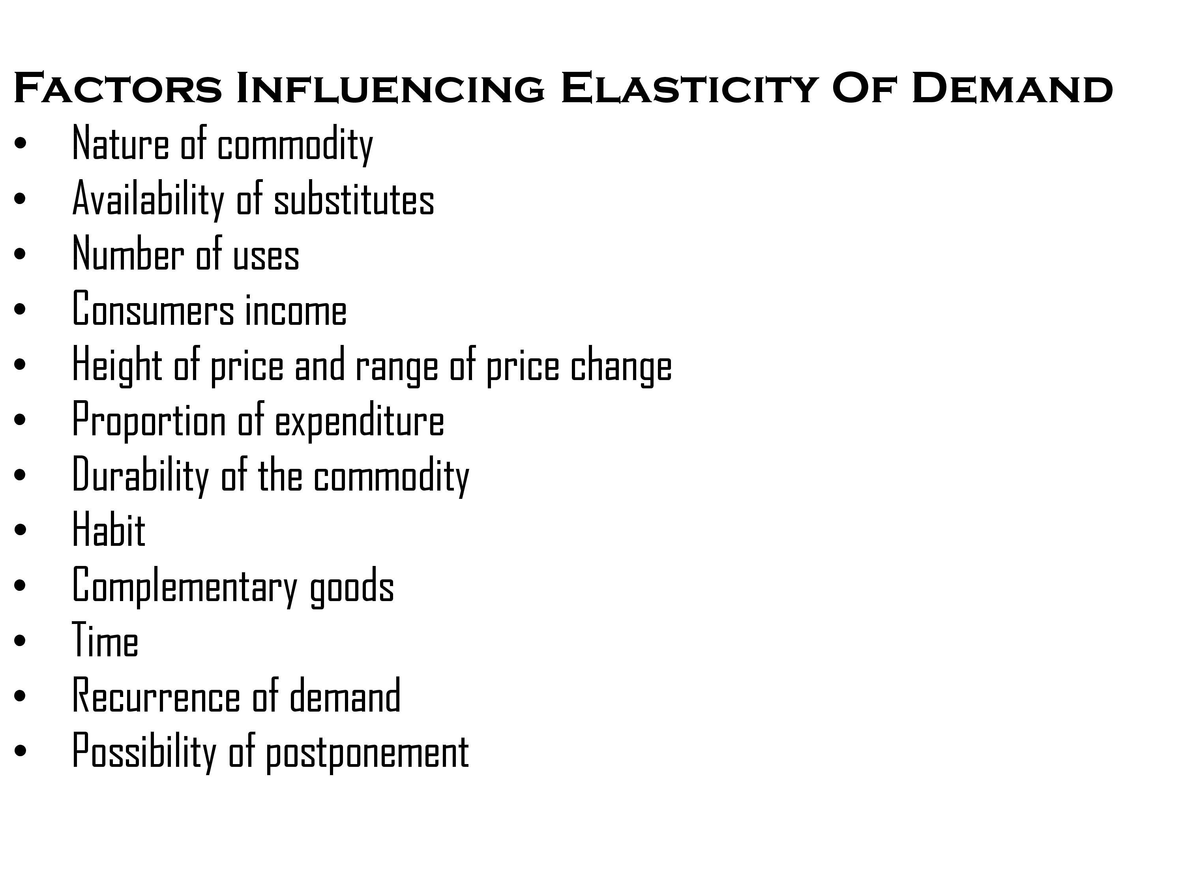

Slide 16


Slide 17
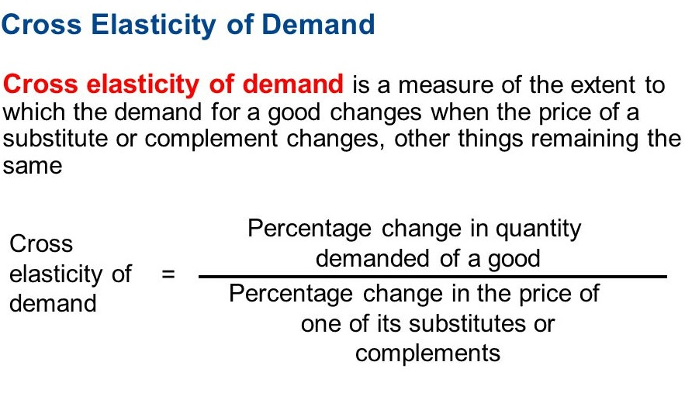

Slide 18
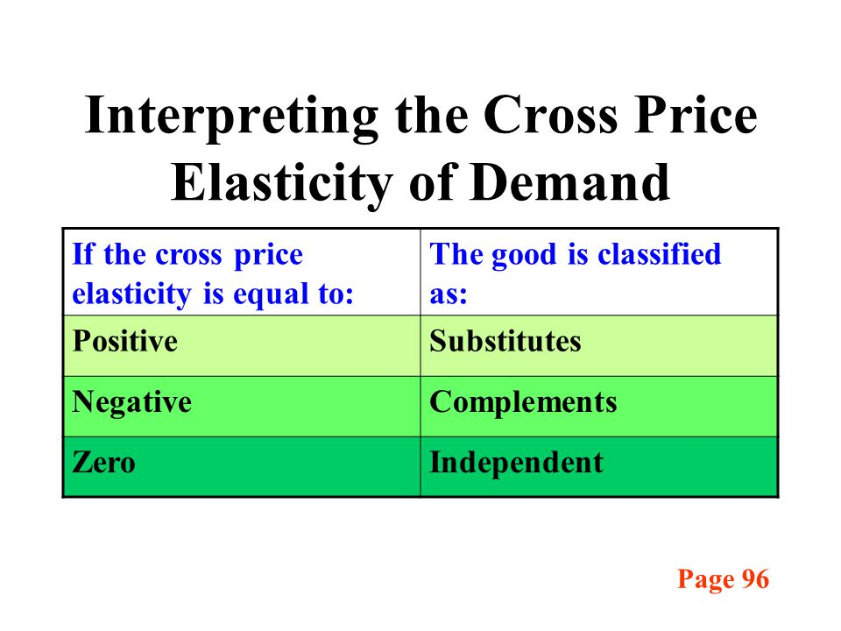

Slide 19
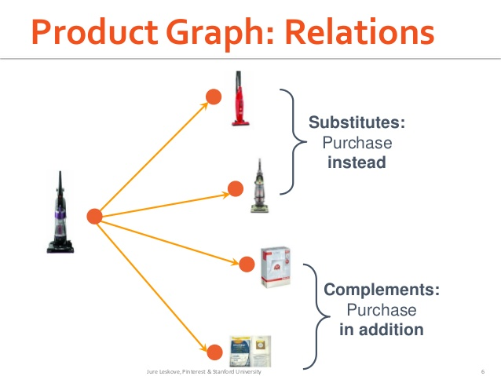

Slide 20
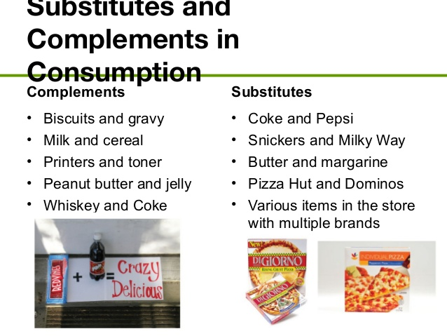

Slide 21
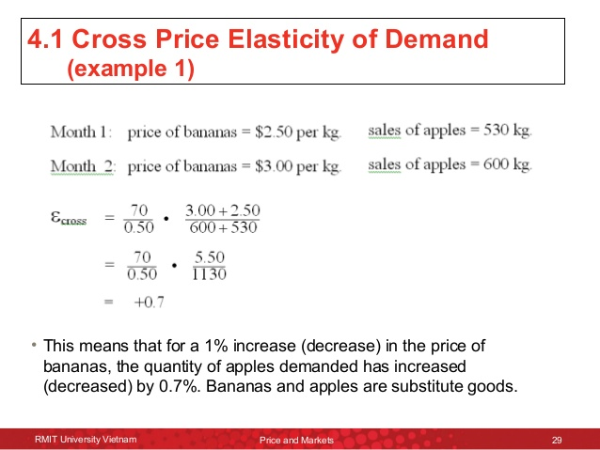
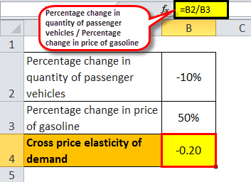
Measuring Cross Elasticity of Demand Simple Problem

Slide 22
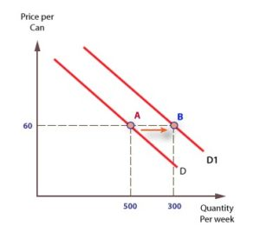
What is Advertising?
Advertising consists of those activities by which visual or oral messages are addressed to selected respondents for the purpose of informing and influencing them to buy products or services or to act or be inclined favorably toward ideas, persons, trademarks, institutions or association featured.
Functions of Advertising:
a). To shift the demand curve to the right
b). To reduce the elasticity of demand

Slide 23
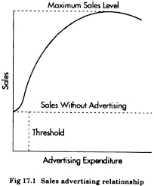
Salient features of the Advertising-Sales Relationship
1. A certain amount of sales is possible even without any advertising.
2. Otherthings, i.e., price, quality, channels of distribution remaining the same, there is a direct relationship between the extent of advertisement and the volume of sales. Thus, an increase in the expenditure on advertisement is likely to lead to an increase in sales.
3. Up to a point, an increase in advertisement will lead to a more than proportionate increase in sales. But beyond this point, an increase in advertisement will lead to a less than proportionate increase in sales till the saturation point is reached after which there will no increase in sales.

Slide 24
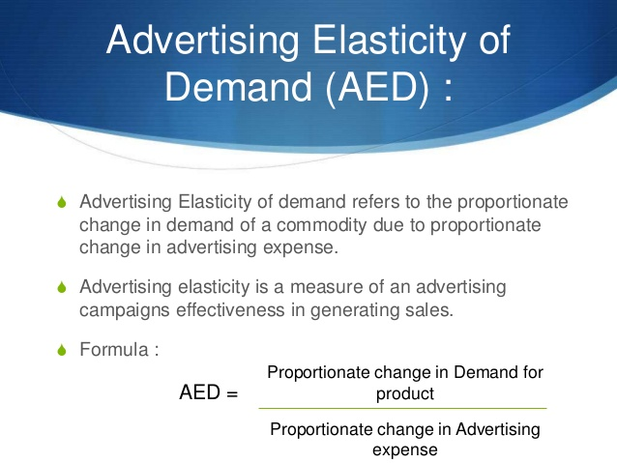

Slide 25

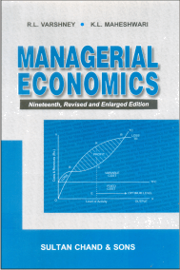
References

